Slide 1
ATM TRANSACTION
CT4 MINI PROJECT

Slide 2
ATM TRANSACTION SYSTEM
IT’S A PROJECT ABOUT ATM TRANSACTION USING C PROGRAM.
IT CONSISTS OF
CASH WITHDRAWAL
CASH DEPOSIT
MONEY TRANSFER
BALANCE ENQUIRY

Slide 3
CODE
#include <stdio.h>
int amounttowithdraw , amounttodeposit ,othertransaction,password,pin ;
int totalamount,balanceaftertransfer,transfer;
float balance = 10000;
void transaction(){
int choice;printf("enter your password to enter in your account\n");
scanf("%d", &password);
printf("Enter 1 for withdraw. \n");
printf("Enter 2 for deposite. \n");
printf( "Enter 3 for check balance. \n");
printf("Enter 4 for transfer. \n"); scanf("%d", &choice);

Slide 4
switch(choice){
case 1: printf("Please enter amount to withdraw: ");
scanf("%d", &amounttowithdraw);
if(amounttowithdraw > balance){
printf("There is no insuffient balance in your account");
printf("Press 1 to exit\n");
scanf("%d", &othertransaction);
if(othertransaction == 1){
transaction();
}
}
else
{

Slide 5
balance = balance - amounttowithdraw;
printf("You have withdrawn %d and your new balance is %f ", amounttowithdraw, balance);
printf("\nDo you want another transaction?\nPress 1 to proceed and 2 to exit\n");
scanf("%d", &othertransaction);
if(othertransaction == 1){
transaction();
}
}
break;
case 2:
printf("Please enter amount to deposit: ");
scanf("%d", &amounttodeposit);

Slide 6
balance = amounttodeposit + balance;
printf("Amount deposited, new balance is: %f", balance);
printf("\nDo you want another deposit?\nPress 1 to proceed and 2 to exit\n");
scanf("%d", &amounttodeposit);
if(amounttodeposit == 1){
transaction();
}
break;
case 3: printf("Your bank balance is: %f", balance);
break;
case 4:printf("Enter amount to tranfer\n");

Slide 7
scanf("%d", &transfer);
int balanceaftertransfer;
balanceaftertransfer = balance-transfer;printf("Net balance after transfer is %f", balanceaftertransfer);
break;
}
}
int main(){
transaction();
return 0;
}

Slide 8
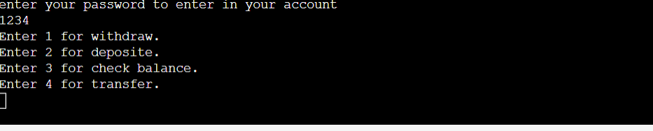
OUTPUT

Slide 9
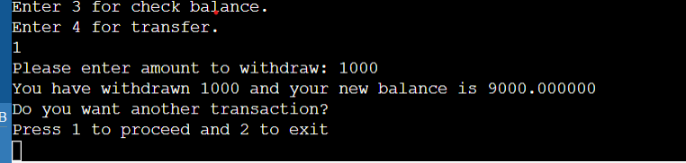
CASH WITHDRAW

Slide 10
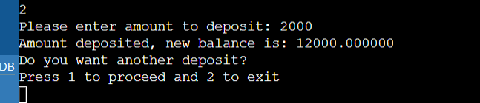
CASH DEPOSIT

Slide 11
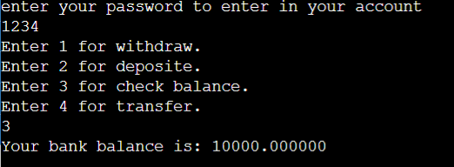
BALANCE

Slide 12
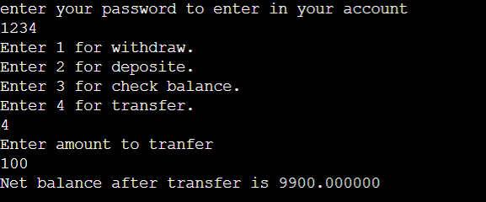
MONEY TRANSFER

Slide 13
DONE BY-
NITHISH KUMAR(RA2111019010068)
JEYASURYA(RA2111019010055)
SRIDARAN(RA2111019010051)
BATRIC(RA2111019010068)

Slide 14


